Slide 1
Hadoop Map-Reduce
2017.3
XenRon

Slide 2
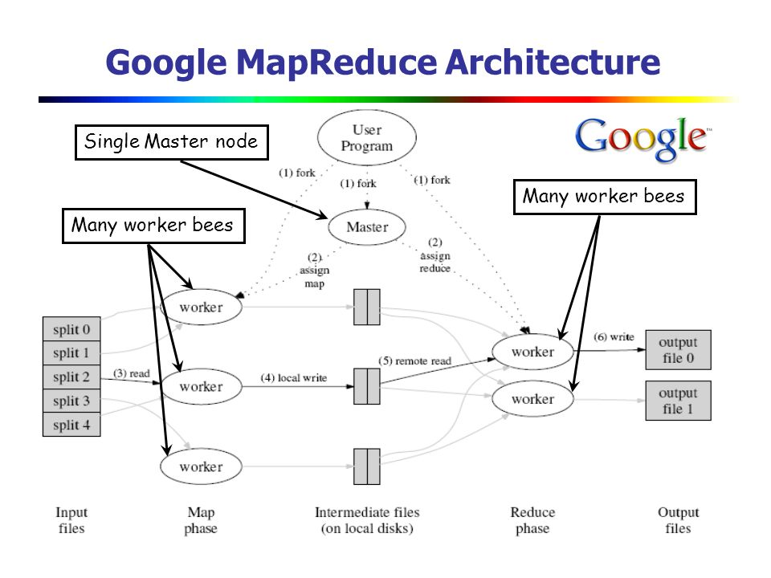
CONTENTS
01
Map-Reduce
02
Computation Modal
03
Word Count
04
Use Case

Slide 3
Review
Review

Slide 4



Review

Slide 5
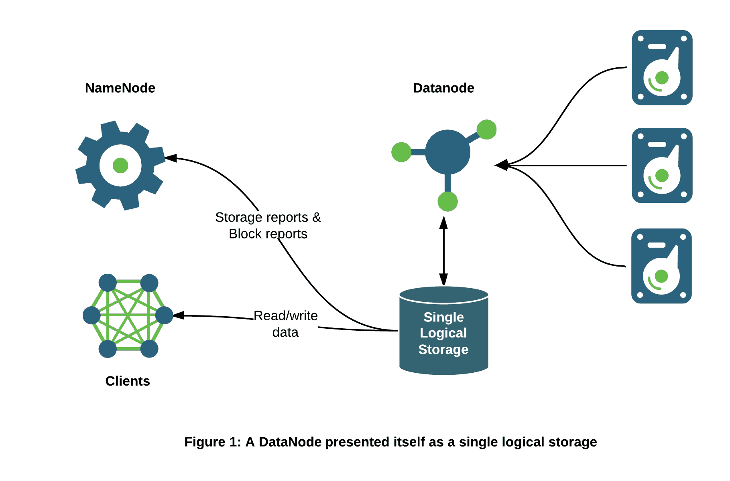
Review

Slide 6
PART0
Preliminary Topics
事前準備

Slide 7
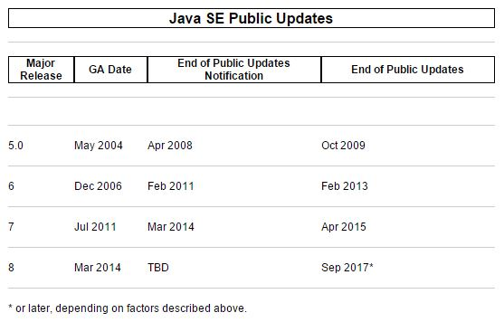

Java
http://www.oracle.com/technetwork/java/eol-135779.html

Slide 8

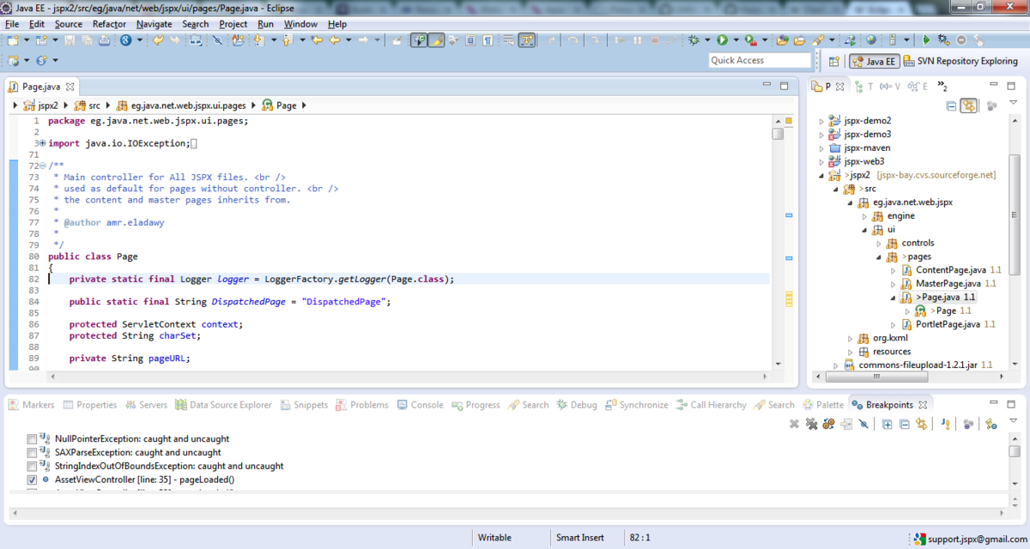
IDE

Slide 9

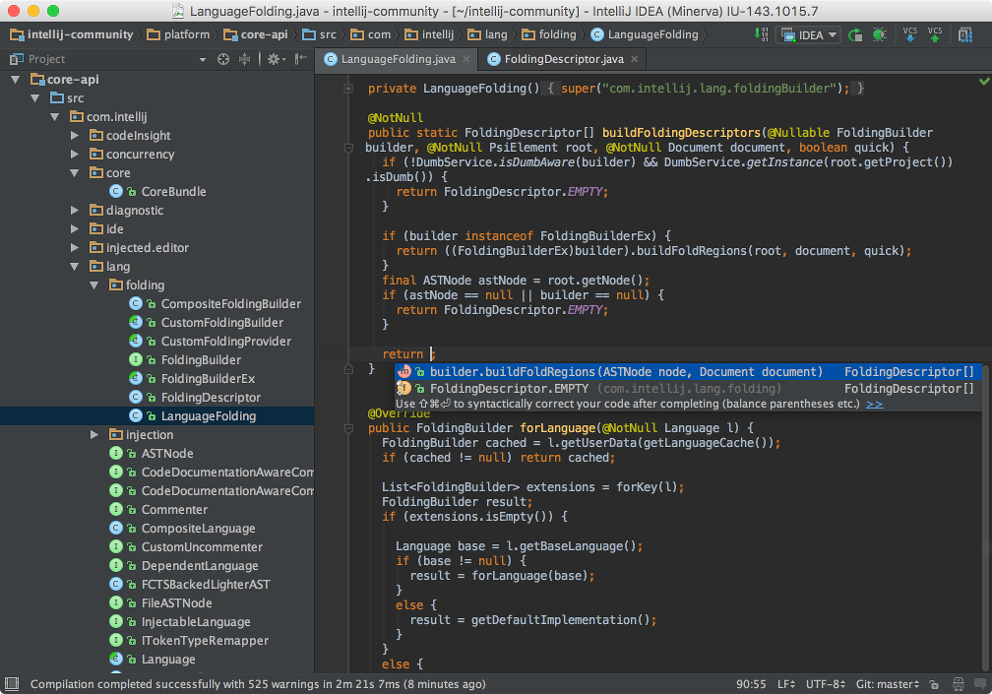
IDE

Slide 10

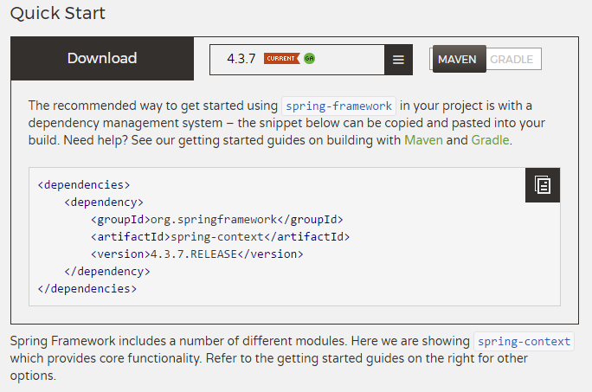


Dependency Management

Slide 11

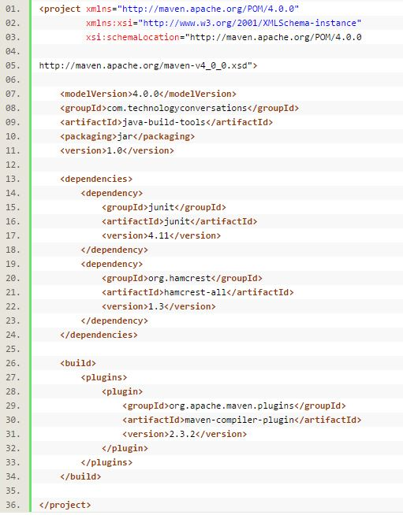
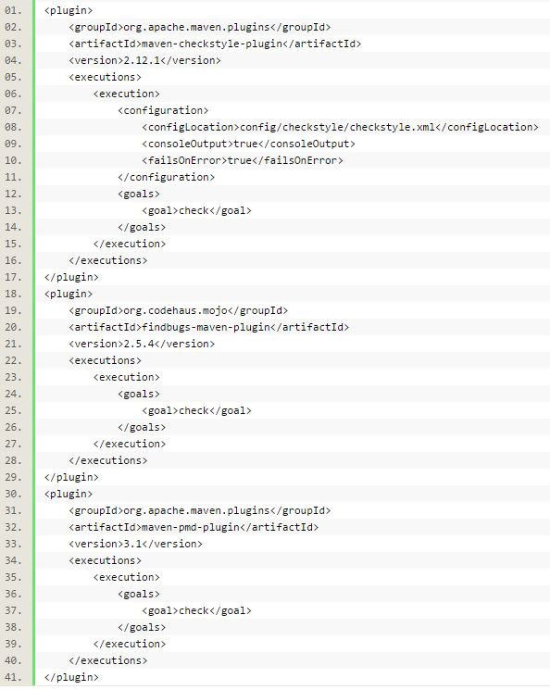
Dependency Management

Slide 12
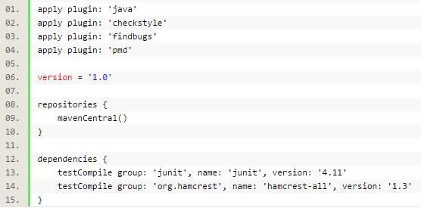
Dependency Management

Slide 13
PART1
Map-Reduce

Slide 14
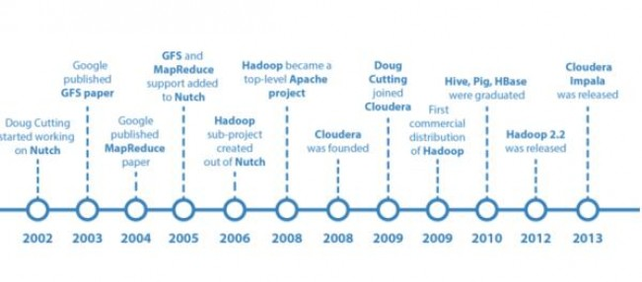
Google

Slide 15
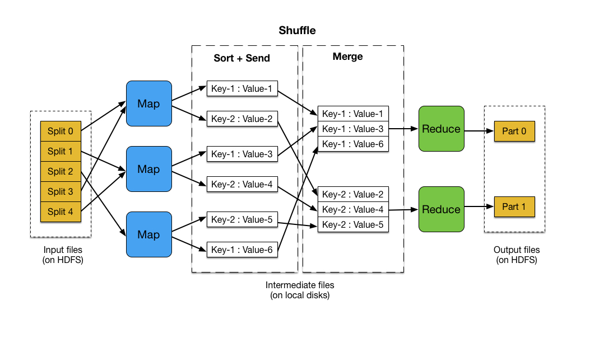
Map Reduce

Slide 16
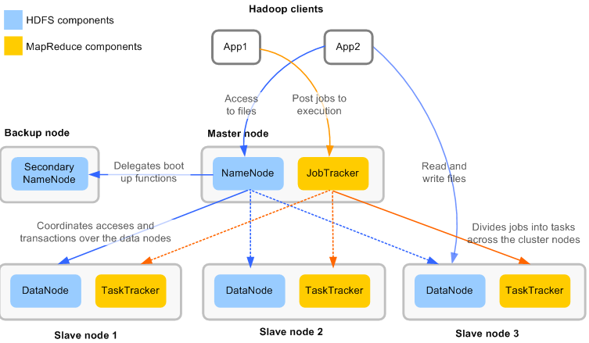
Map Reduce

Slide 17
Map Reduce

Slide 18
Map Reduce

Slide 19
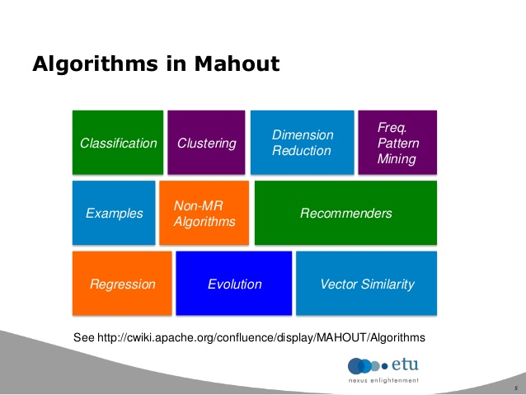
Map Reduce

Slide 20
PART2
Computation Modal
計算模型

Slide 21
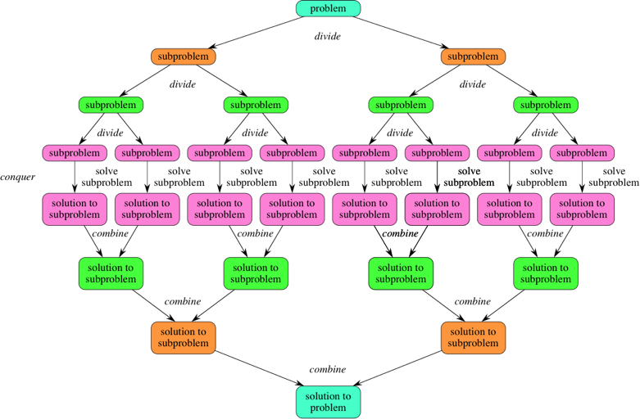
Divide & Conquer

Slide 22
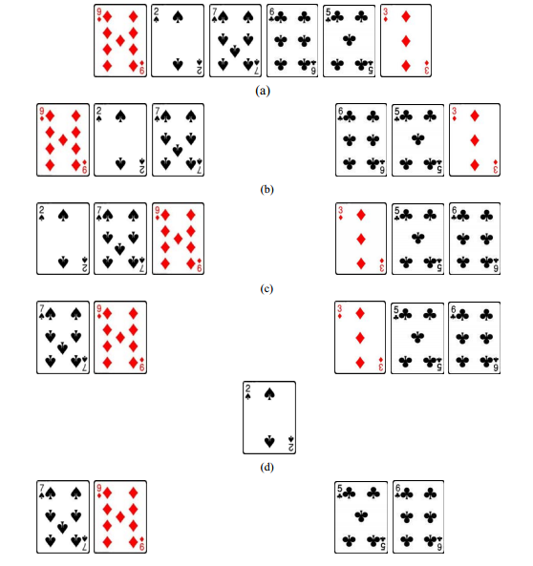
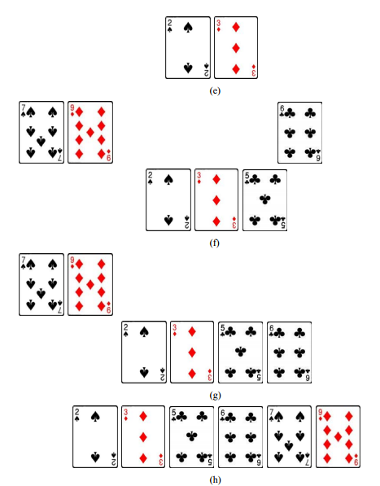
Divide & Conquer

Slide 23
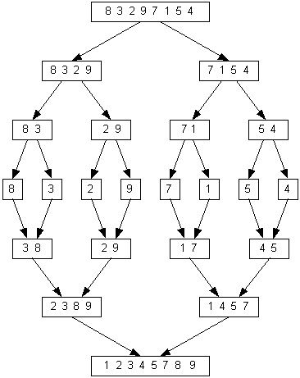
Divide & Conquer

Slide 24
PART3
Word Count

Slide 25
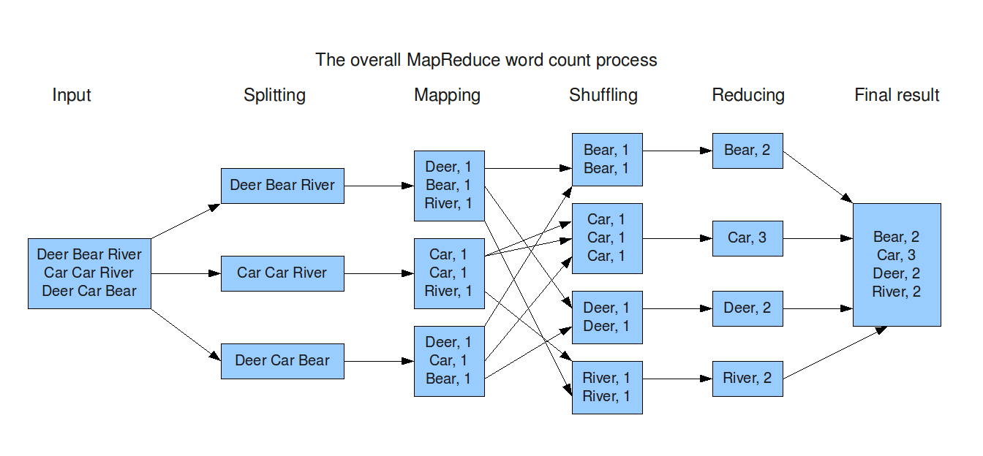
Word Count

Slide 26
Word Count

Slide 27
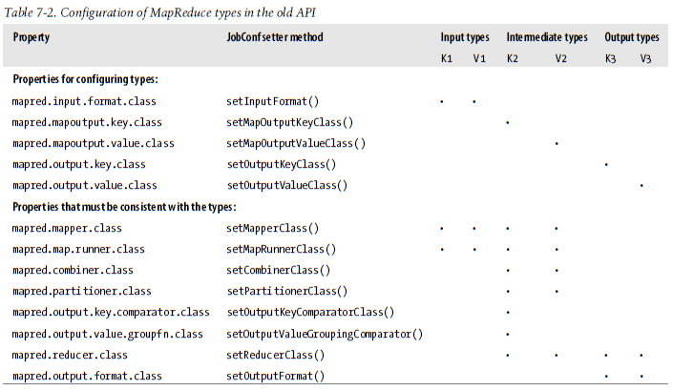
MapReduce API

Slide 28
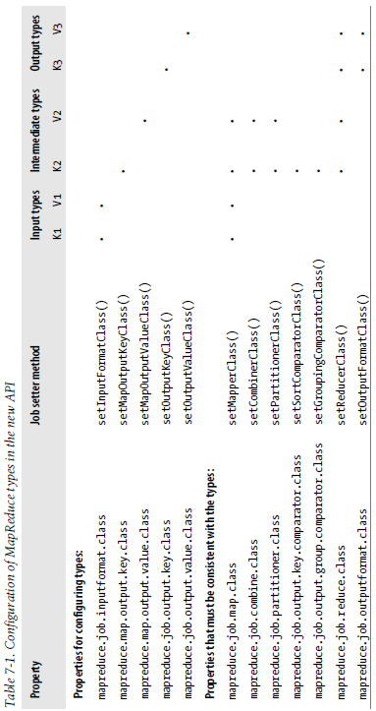
MapReduce API

Slide 29
PART4
Use Case

Slide 30

KPI

Slide 31
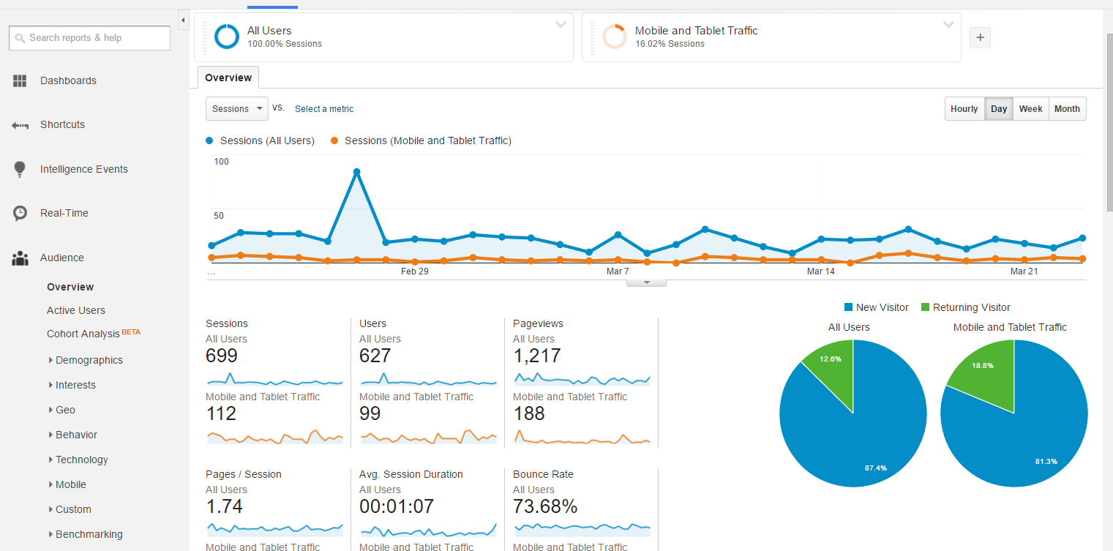
KPI

Slide 32

LBS

Slide 33
PART5
Reference Books

Slide 34
Books

Slide 35
HomeWork

Slide 36
The End

